Slide 1
Wines Around the World

Slide 2
Contents
Make Effective Presentations
Using Awesome Backgrounds
Engage your Audience
Capture Audience Attention

Slide 3
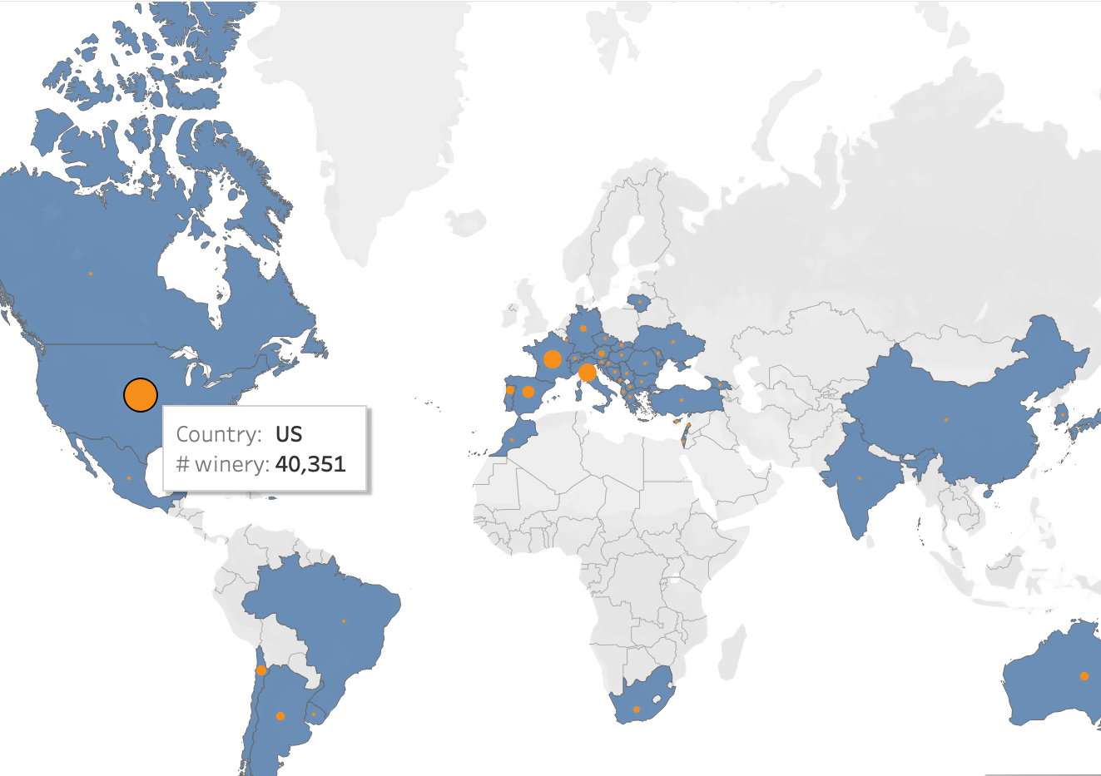
World Distribution

Slide 4
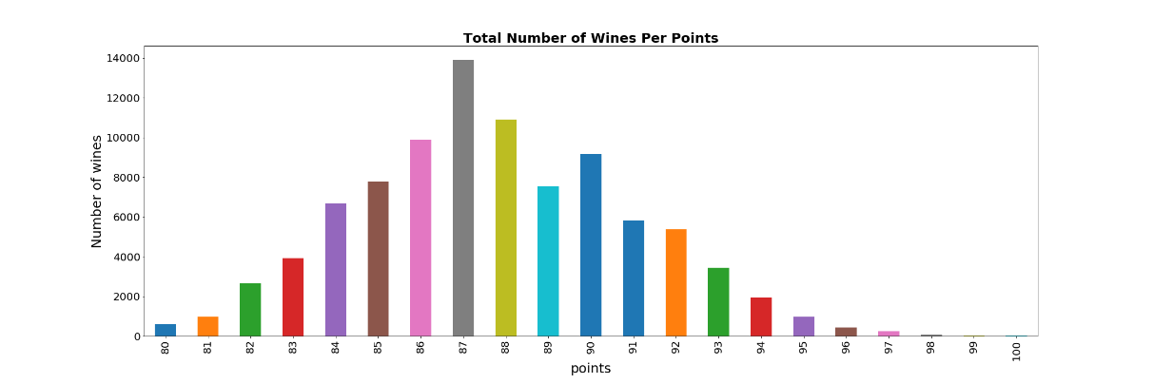
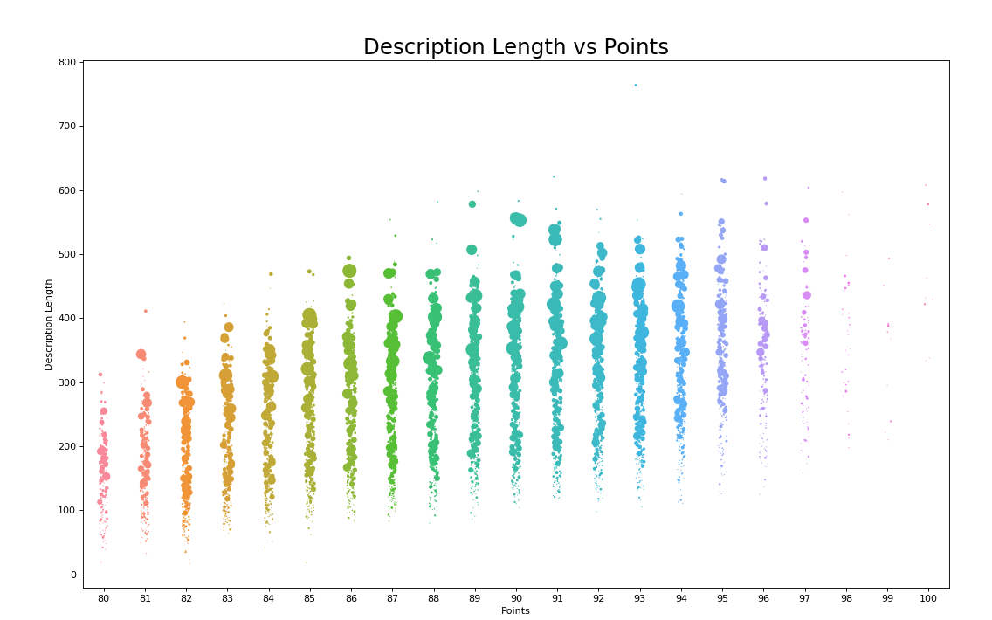
Wine Classification

Slide 5
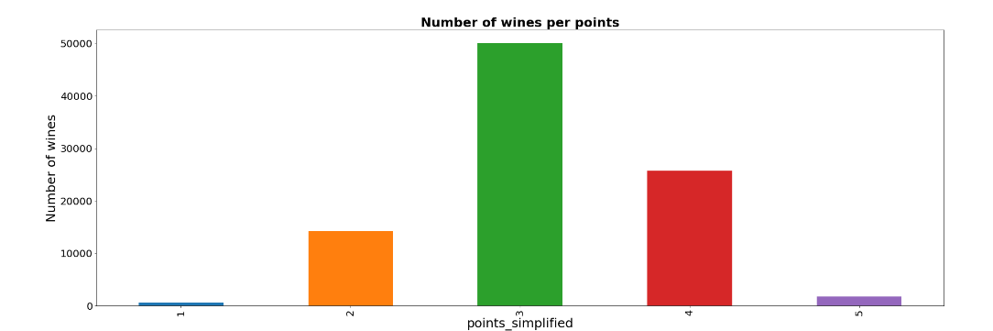
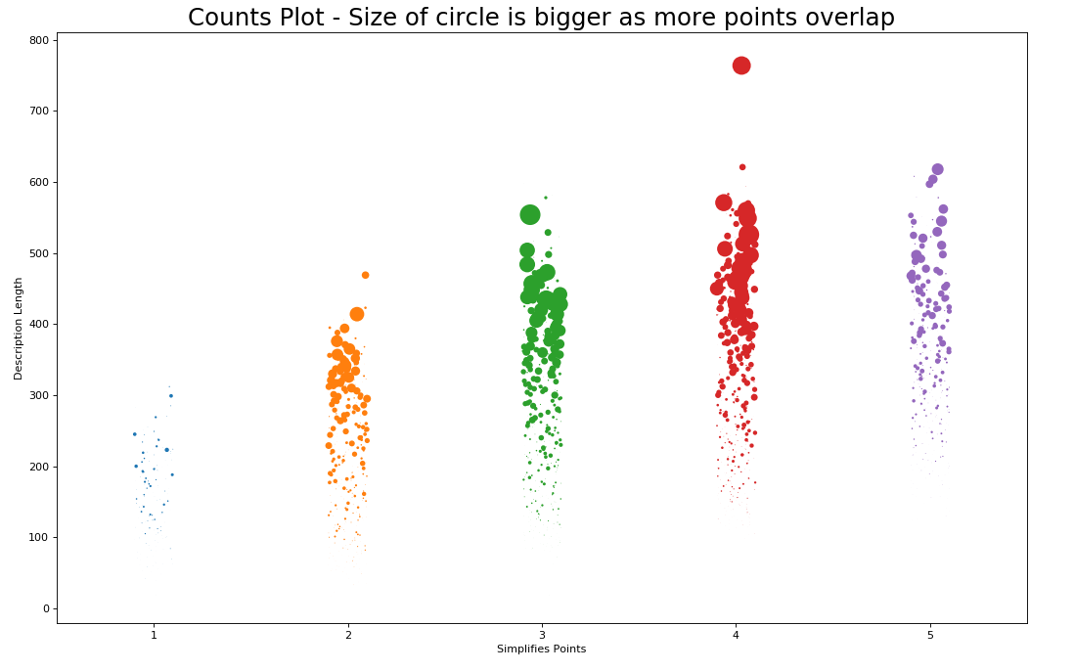
Wine Classification (simplified)

Slide 6
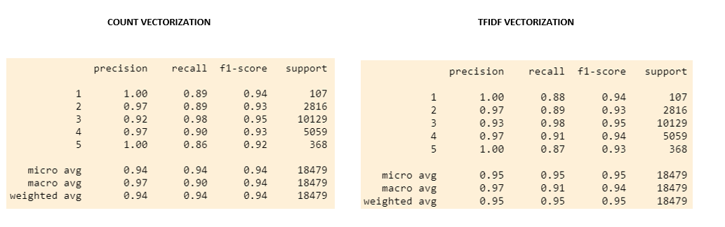
Correlation Between Description Length and Points

Slide 7
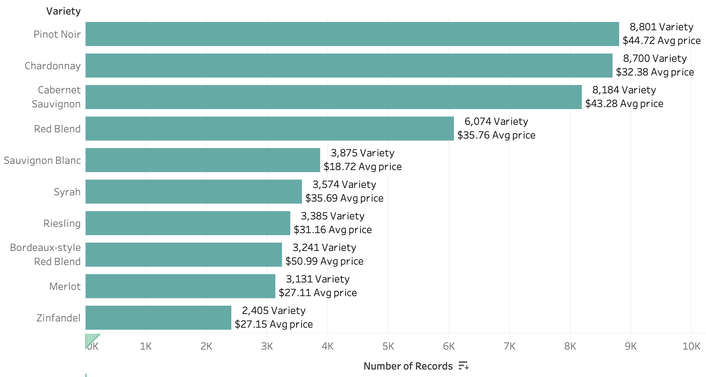
Top 10 World Varieties

Slide 8
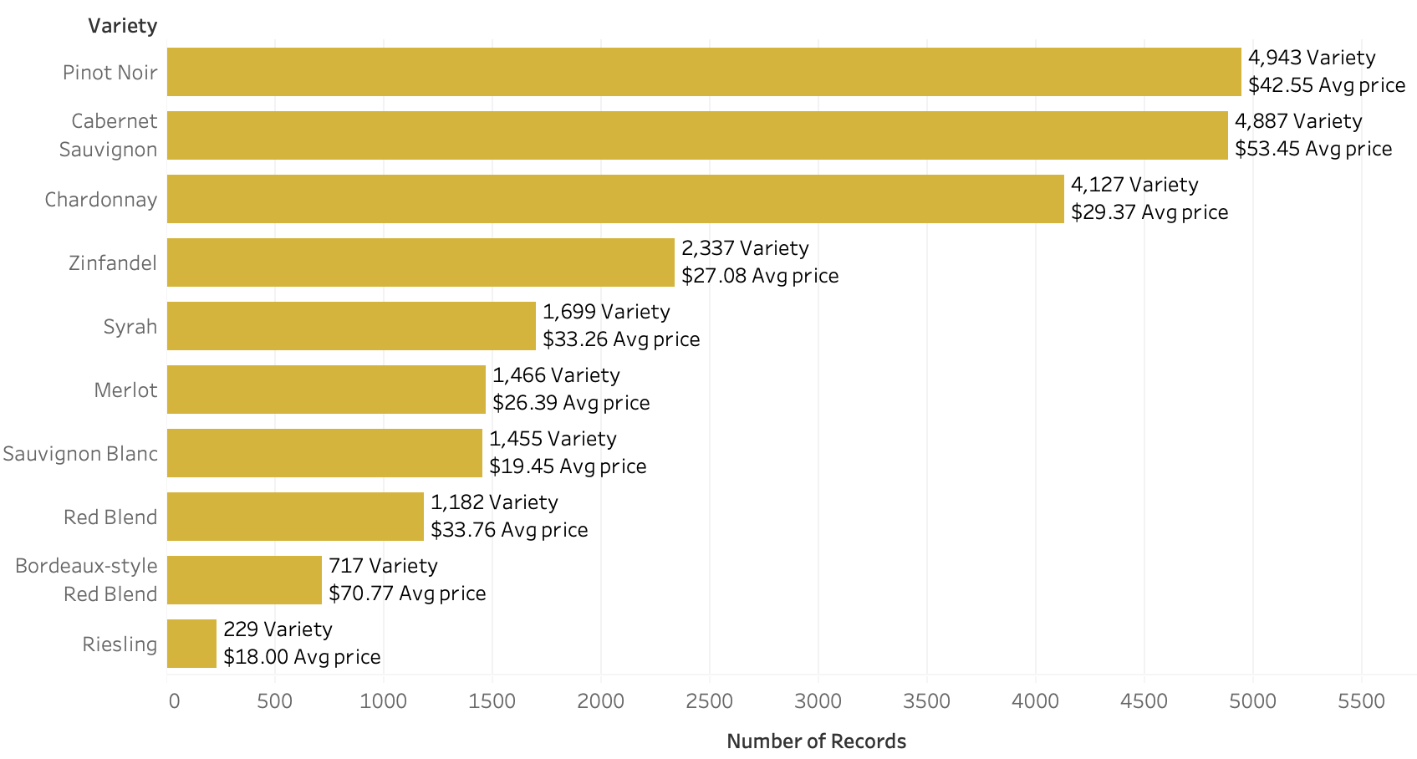
Top 10 California Varieties

Slide 9
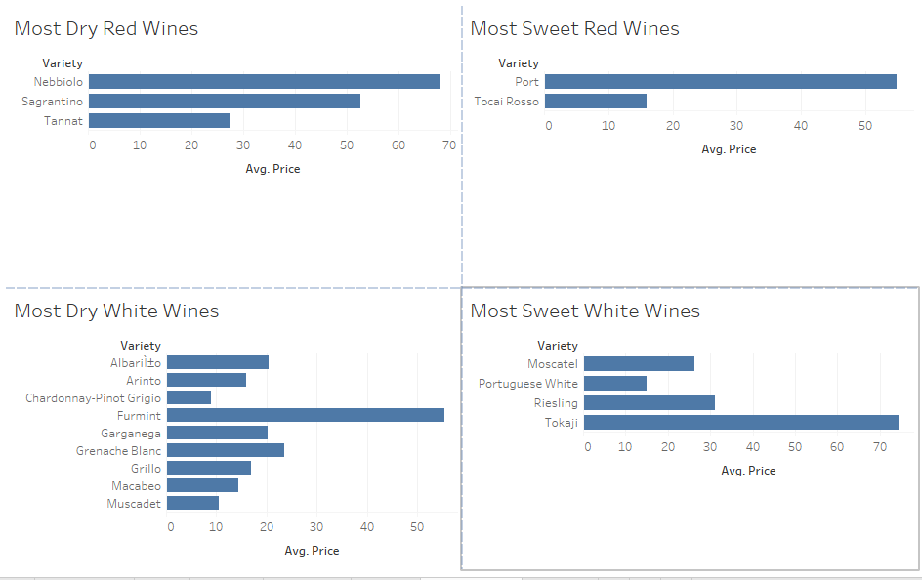
From Dry to Sweet

Slide 10
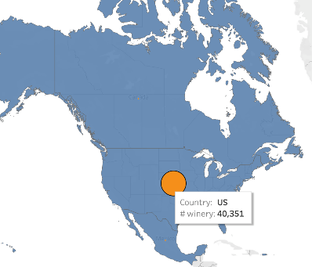
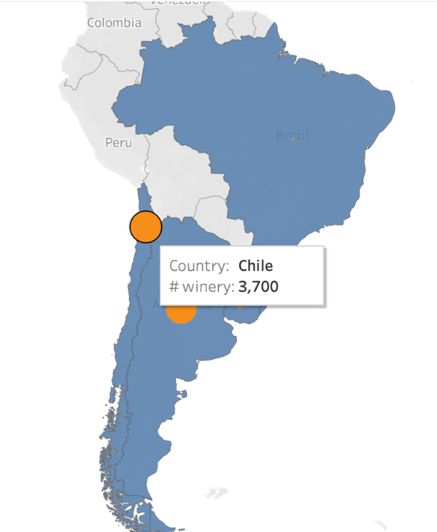
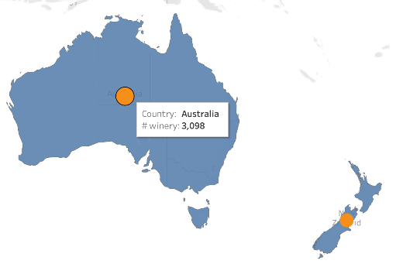
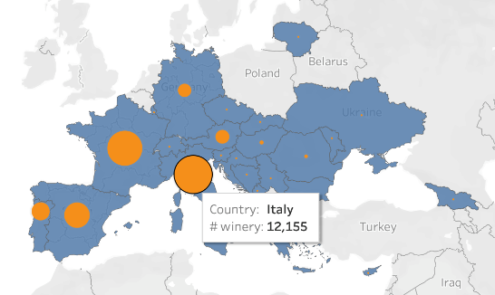
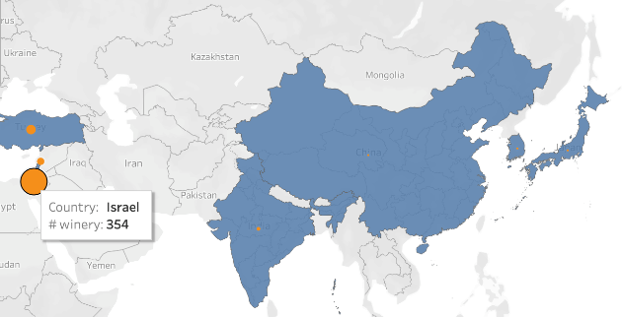
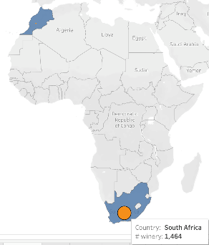
Top Countries per Region

Slide 11
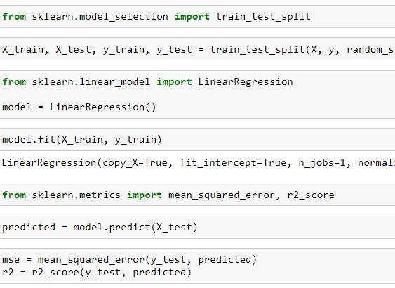
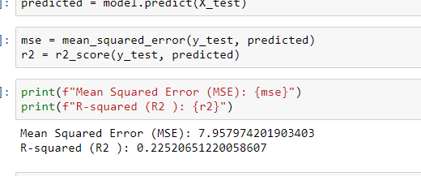
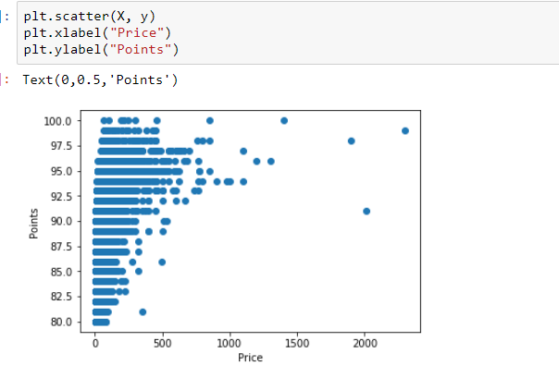
Correlation Between Points and Price

Slide 12
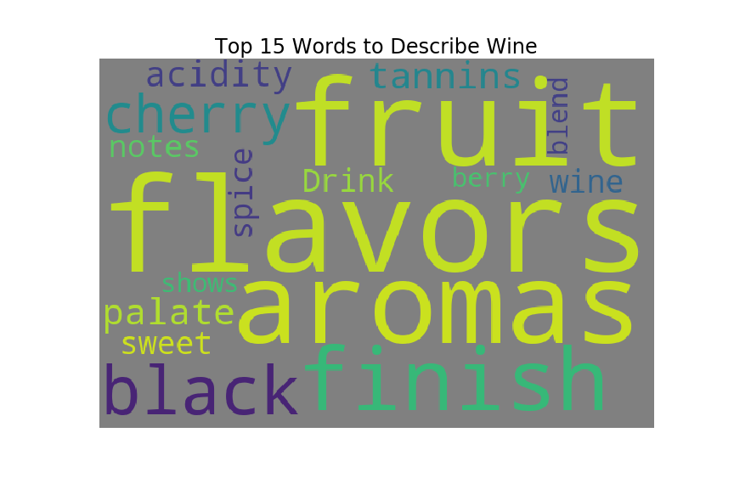
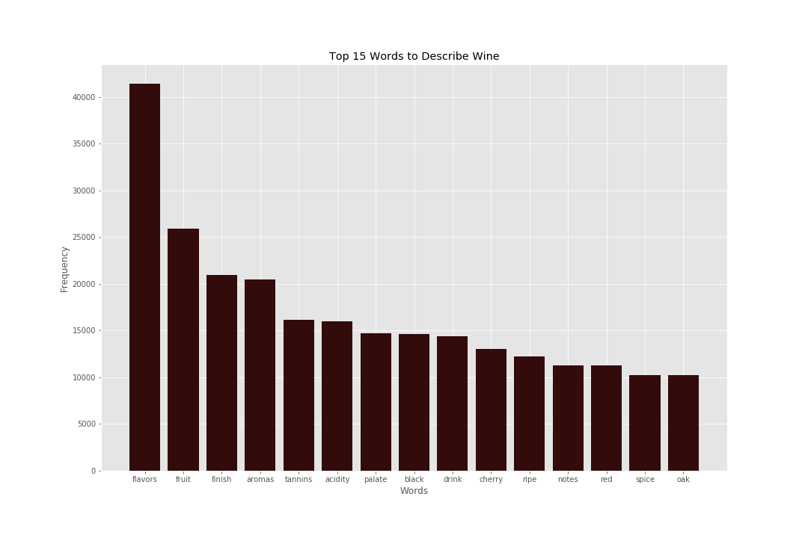
Fun Facts

Slide 13
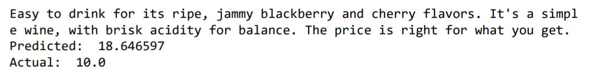
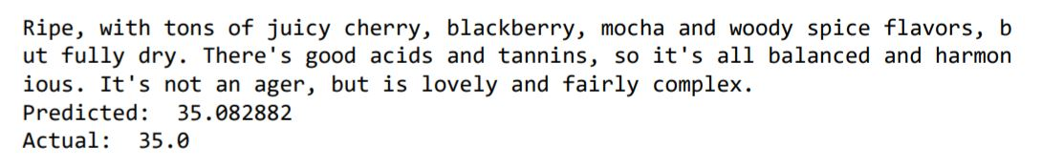
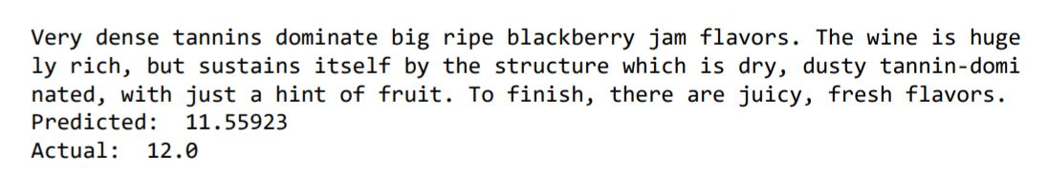
Is it possible to predict the price of a wine based on its description and variety?
Yes, it is possible.

Slide 14
Appendix
Slide # | Content
3 | Tableau
4 | Python Matplotlib
5 | Python Matplotlib
6 | Count and TFIDF Vectorizations
7 | Tableau
8 | Tableau
9 | Tableau
10 | Tableau
11 | Linear Regression
12 | Python Matplotlib
13 | Pandas, Tensorflow, Tokenizer,

